Slide 1
Hackathon
Create an App about music
2021 Edition
25 Nov - 26 Nov

Slide 2
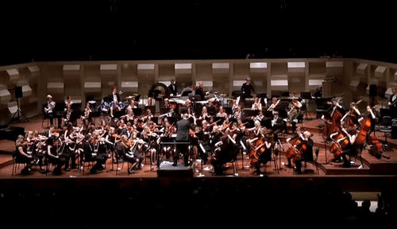
Music maestro !

Slide 3

What’s a
Hackathon / Datathon?
An event where people work collaboratively using computer programming to solve technical challenges.

Slide 4
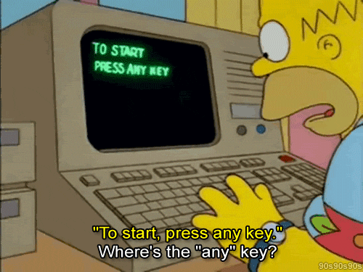
On the same topic:
600 wilders
120 teams

Slide 5
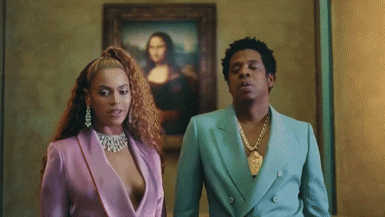
Pitch
“If you put your mind to it, you can accomplish anything.” - Emmett Brown
Wilders have the power to enjoy music time and use all their technology to do it.
Wilders have to create an application that can be perfectly adapted to the needs of everything in music (groups, singer, companies, etc)
Be creative & have fun Wilders !

Slide 6
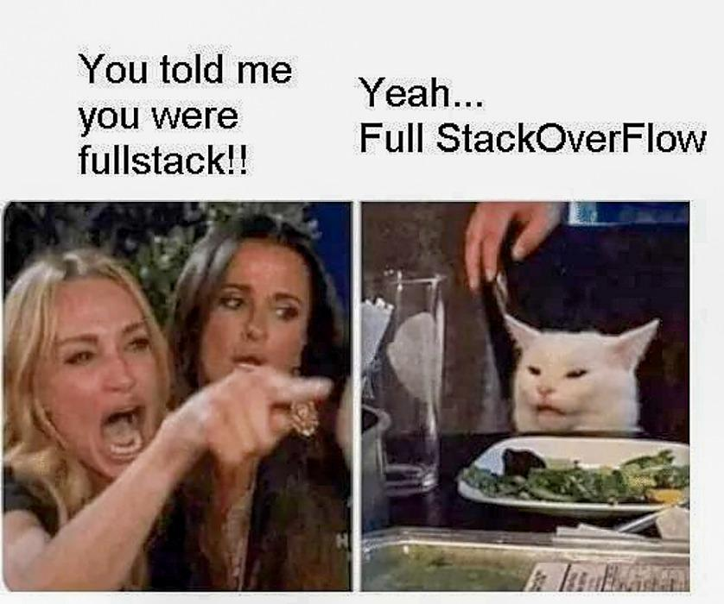
Team members
Group of 4/6 peoples
Give a name to your group and indicate it to your SEM

Slide 7

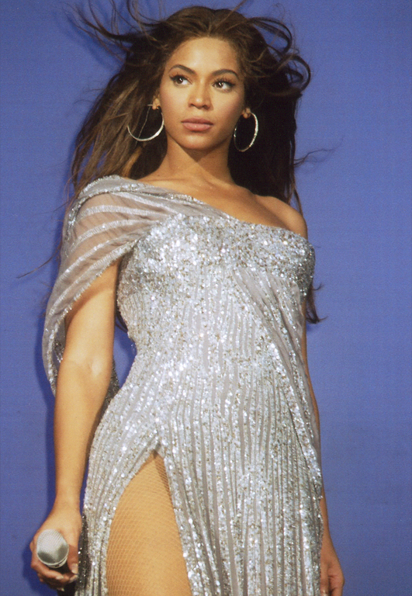
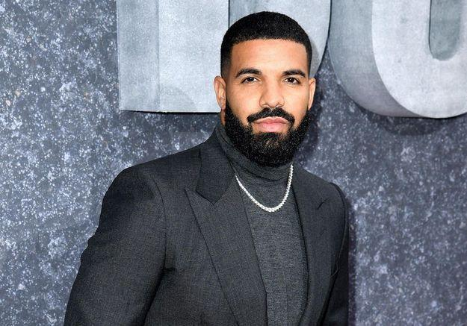
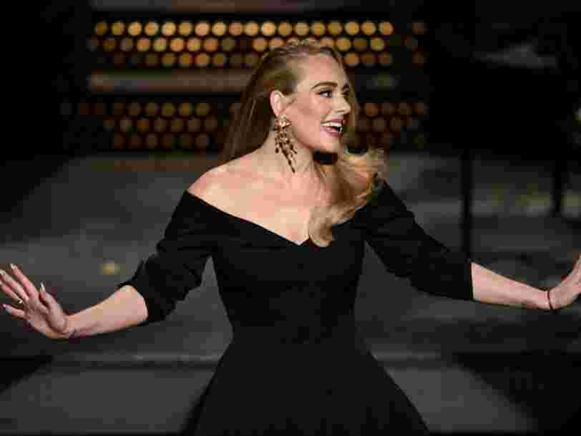
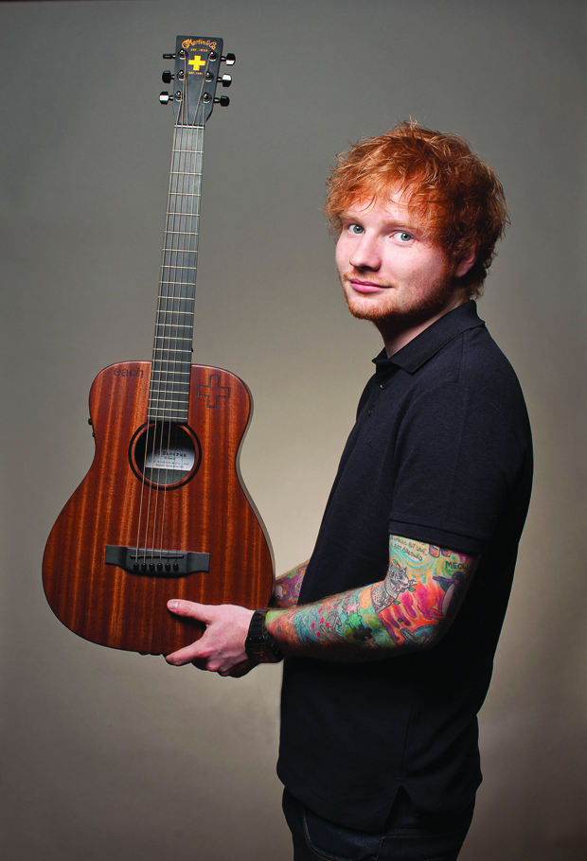
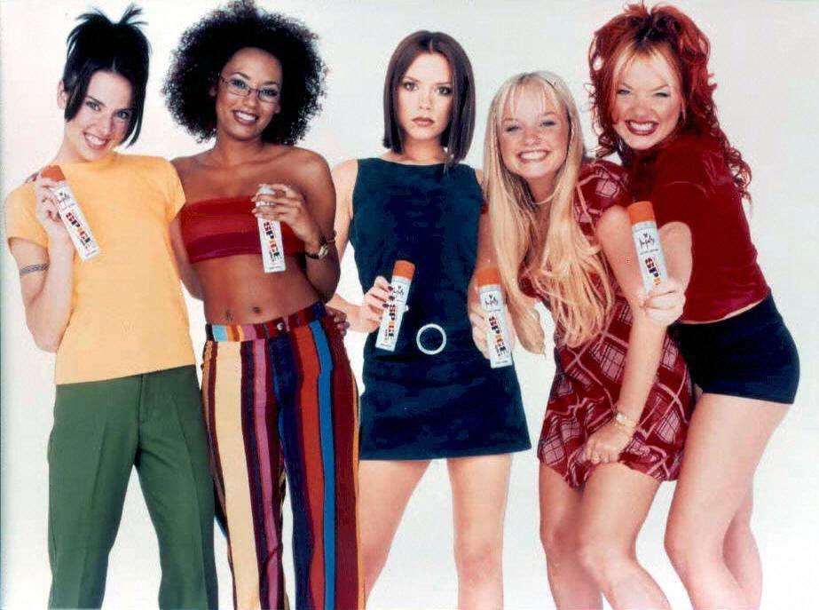
Choose the music you want !

Slide 8
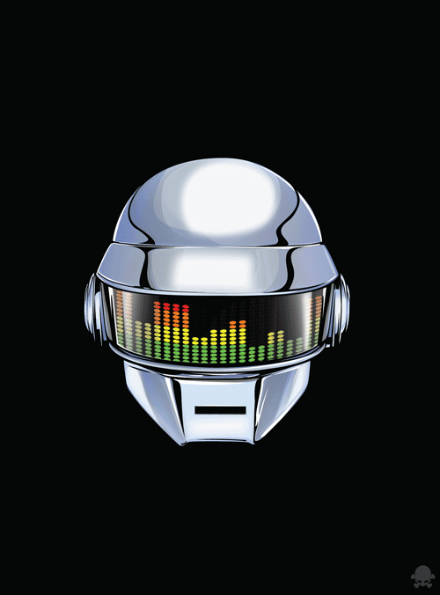
Some good API’S to bring with you !
Useful & Free APIS
To help you provide data and information to your users from another time, you still have access to the Rest APIs below. Use and consume them to help your new contemporaries.
https://github.com/public-apis/public-apis

Slide 9
Tips for Hackathon

Slide 10
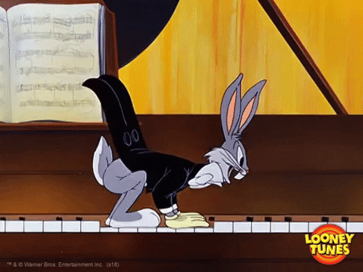
What do we expect of the devs ?
It could give apps of the type :
🎸 Sharing / generating playlists
🎸 Topics around webradios
🎸 Tinder like to form a rock band
🎸 Guitar hero style game
There are a few APIs around music (without authentication).
Here are some examples :
🎷 Spotify (possible without auth)
🎷 Web radios
🎷 Lyrics
🎷 API music list

Slide 11
Tips for Datathon

Slide 12
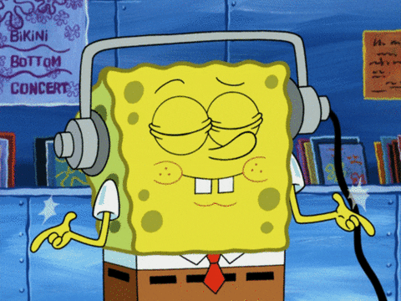
What do we expect of the data analyst ?
Your goal is to produce an analysis that will be useful to music stakeholders. The stakeholders are the music producers, the musicians and of course the listeners.
For example, an analysis that will be useful to music producers to know which genre is the most produced at the moment?
Or an application useful to listeners with a recommendation of music according to their tastes.
Or where are the nearest concerts located? Are there really more festivals in summer?
What has been the impact of Covid on the number of concerts?
It’s only examples of questions ! You’re totally free to choose another one. The only constraints is to be useful to music stakeholders.

Slide 13


What do we expect of the data analyst ?
There are a few datasets around music (and of course, you can take the checkpoint’s dataset).
Here are some examples, and you can take external data:
🎷 LastFM extract
🎷 Rateyourmusic extract
🎷 French events (concerts, etc…)
🎷 Liste d'API music

Slide 14
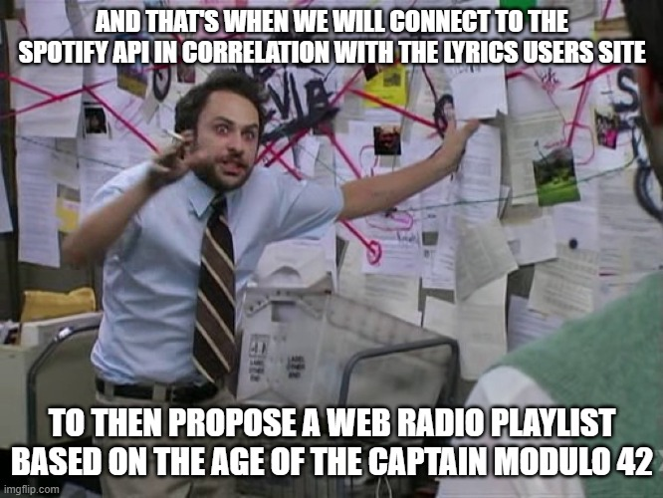
Schedule
Nov 25, 2021 @9:00am-9h30am | Hackathon Kick-off Google Meet
Nov 25, 2021 @10am to Nov 26, 2021 @12pm | Brainstorming ! Think before do
Nov 25, 2021 @12pm to Nov 26, 2021 @2pm | At your keyboard ! Time to create.
Nov 26, 2020 @2pm | Demo @2pm

Slide 15
Judging criteria
UX DESIGN
(only for dev)
TECHNICAL ASPECTS
CONCEPT
ORAL PRESENTATION

Slide 16
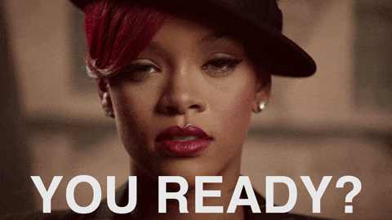
LET’S GO !!!

